Slide 1
Asset Retirement Obligation Management Planning Using
SAP Analytics Cloud (SAC)
28/06/ 2023

Slide 2
Webinar Agenda
01
Introduction to VIZIO
Demo:
Asset Retirement Obligation Management Planning Accelerator
02
03
Closing Remarks
04
Q&A
2

Slide 3
Presentation Disclaimer
SAP Analytics Cloud platform is the sole registered property of SAP.
VIZIO offers implementation services on SAC.

Slide 4
Section 1: Introduction to VIZIO

Slide 5
Welcome to VIZIO
VIZIO is a boutique AWS & SAP solution provider operating in Canada and the US.
We specialise in BI, Analytics & FP&A solutions.
We offer End-2-End implementation & support services.
Know more
5

Slide 6
VIZIO’s Technology Services
Our Services
SAP
AWS
On Premise
Business Technology Platform (BTP)
Accelerators
Redshift
Glue
S3
Athena
QuickSight
BW/4HANA
BPC (E)
SAP Analytics Cloud
SAP Datasphere
HANA Cloud
Set Up & Configuration
SAP Analytics Cloud
HANA Cloud
HANA
Planning & Budgeting
Business Applications
Custom Widget
IS Utilities
IS Real Estate
IS Utilities
IS Real Estate

Slide 7
Planning & Budgeting Accelerators Built on SAP SAC
Our planning & budgeting accelerators, built on the SAP Analytics Cloud platform, can be divided as follows:
SAP Analytics Cloud
Planning & Budgeting
Custom Widgets
Workforce Planning
Salary & Benefits Planning
OPEX Planning
Ongoing CAPEX Planning
New Capital Project Planning
Asset Management Planning
Profitability Planning
Integrated Risk Profiling & CAPEX Planning

Slide 8
Business Application Built on SAP SAC
Using the SAP Analytics Cloud platform, we have built our Asset Retirement Obligation Management Template as a business application
SAP Analytics Cloud
Business Application
Asset Retirement Obligation Management

Slide 9
VIZIO‘s FP&A Accelerators
Pre-built FP&A processes based on best practices
Rapid deployment due to 80% - 90% process pre-built solution
Demo ready to get real time FP&A automation experience
Built on the SAP Analytics Cloud platform (SAP SaaS)

Slide 10
Value Proposition For Municipalities
Why Use VIZIO's FP&A Accelerators
Built as a one size fits all FP&A Solutions
Showcase SAC as a viable replacement of Excel and other manual planning tools
In advance 80% - 90% of standard planning processes to reduce implementation cost significantly
Present SAC as a planning and budgeting tool and business application development tool
Short implementation cycles (8 – 16 weeks)
SAP SAC as a service provides flexible licencing options

Slide 11
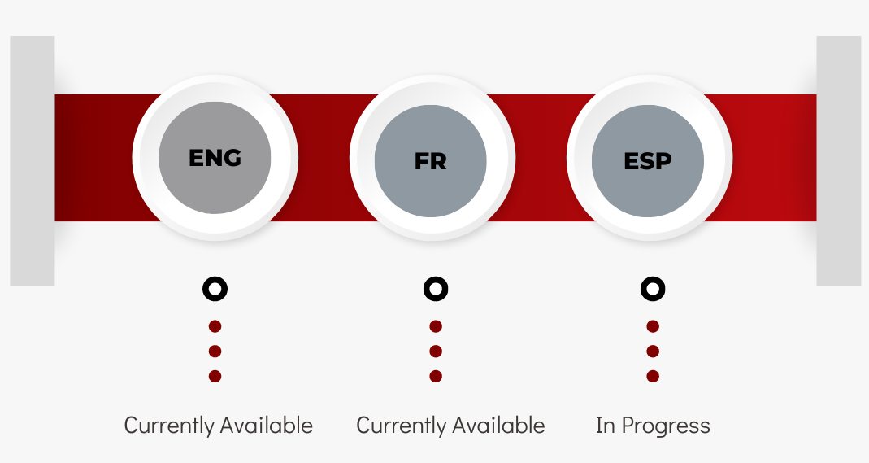
Multilingual Solutions

Slide 12
Section 2 :
DEMO - Asset Retirement Obligation Management Planning Accelertator

Slide 13
What is Asset Retirement Obligation Management

Slide 14
ARO Design Features
Obligation Management
Cost Estimates
Future Value & NPV
Depreciation Calculation
Cashflow Generation
Posting entries
Physical asset linking
Able to use different discount rates
Able to handle multiple legal entities
Obligation
Asset
Depreciaton
Sale of an Asset

Slide 15
LIVE DEMO

Slide 16
Section 3: Closing Remarks

Slide 17
Upcoming Planning Accelerators on SAP SAC
VIZIO’s future pipeline includes the following accelerators:​
Upcoming Accelerators
Revenue Planning
Strategic Workforce Planning
Travel & Event Planning
Procurement Planning

Slide 18
Section 4: Q&A

Slide 19
Let's Connect!
Asma Asaf
Project & Event Manager
asma.asaf@vizioconsulting.com
Sajjad Hassan
SME FP&A Solutions
sajjad.hassan@vizioconsulting.com
+1 (289)-952-8845
info@vizioconsulting.com
+1 (289)-813-9135
www.vizioconsulting.com
2 Robert Speck Parkway, Suite 750 Mississauga, ON L4Z 1H8 Canada
t
l
y

Slide 20
Appendix A
Notes:
remove

Slide 21
Detailed Disclaimer
SAP Analytics Cloud is the sole registered property of SAP. For more information about SAP Analytics Cloud please refer to: https://www.sap.com/canada/products/cloud-analytics/features.html
VIZIO is using SAP Analytics Cloud as a running platform for all our planning templates and content.
The template you will be viewing in today's demo is a basic format of our solution. It can be enhanced and expanded to meet the individual needs of each client with minimum effort. Keeping this in mind, implementation timelines for each project are impacted by data sets and conditions provided by each respective client.
The information in this presentation is not a commitment, promise or legal obligation to deliver any code, material or functionality.
This presentation is for informational purposes only and may not be incorporated in any contract.
All forward statements are subject to various risks and uncertainties that could cause actual results to differ materially from expectations.

Slide 22
VIZIO’s Implementation Capabilities
We offer end-to-end services which include:

Slide 23
VIZIO Industry Experience
The team at VIZIO Consulting has several years of experience working in (but
not limited to) the following industries:
Utilities
Public Sector
Manufacturing
23

Slide 24
VIZIO‘s Accelerators
Key FP&A Features for Municipalities
Full Driver Based Processes
What If Analysis
Multi Year Budgeting (Max 10 Y)
Full Process Tracking
Data Level Security

